Slide 1
Introduction to UML
The Basics

Slide 2
Introduction
Types of Models
Basic Building Blocks
Common Extensions
Key Considerations

Slide 3
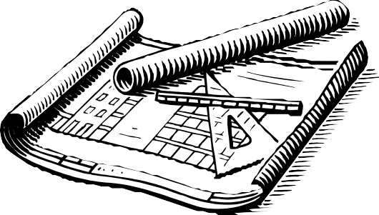
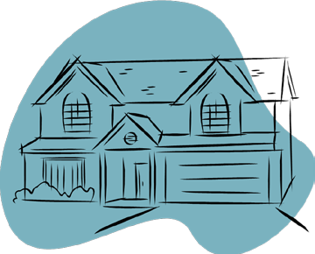
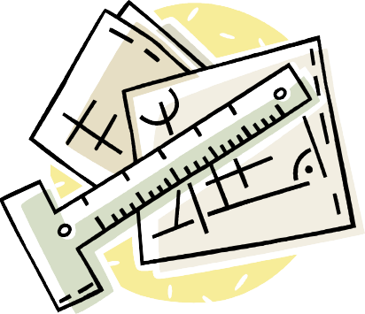
Structural Modeling
Things
Physical
Conceptual
Static Parts
Nouns
Diagrams
Class
Component
Package
Deployment

Slide 4

Behavioral Modeling
Functionality
Processes
Interactions
Dynamic Parts
Verbs
Diagrams
Use Case
Sequence
State
Activity

Slide 5
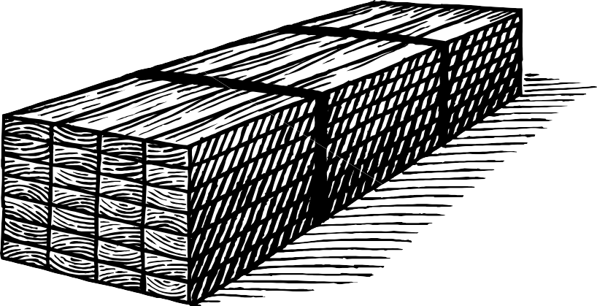
Building Blocks
Things
Relationships

Slide 6
Things – “Boxes”
Account
balance
Deposit() Withdrawal()
Authenticate User
Class
Use Case
Online Bill Payer
Database Server
Component
Node

Slide 7
Things – “Messages and Actions”
Message()
Return
Scheduled
AsynchronousMessage()
Messages
States
Submit Application
Actions

Slide 8
Relationships
0..2
1
Association
Generalization
Implementation
Dependency

Slide 9

Common Extensions
Add a note to give some details to the association element in a diagram
<<Interface>>
Annotations / Notes
Stereotype
Web Server
Iconic Stereotype

Slide 10
Key Considerations
Keep Diagram Clean
Readable
Focused
Precise
Goals
Visualize
Specify
Document
Keep the Audience in Mind

Slide 11
Summary
Structural Modeling
Behavioral Modeling
Basic Building Blocks
Common Extensions
Key Considerations

